Slide 1
Formal Methods in Software Engineering

Slide 2
Full Computational Tree Logic (CTL*)
CTL* is considered as a superset of CTL and LTL.
CTL* is a powerful temporal logic which combines both the linear time and branching time temporal operators including
state formulas with path quantifiers.
It is much more expressive than CTL and LTL and freely combines the path quantifiers with temporal operators.
CTL* temporal operators (F,X, G, U) are associated with unique path quantifier (E, A).

Slide 3
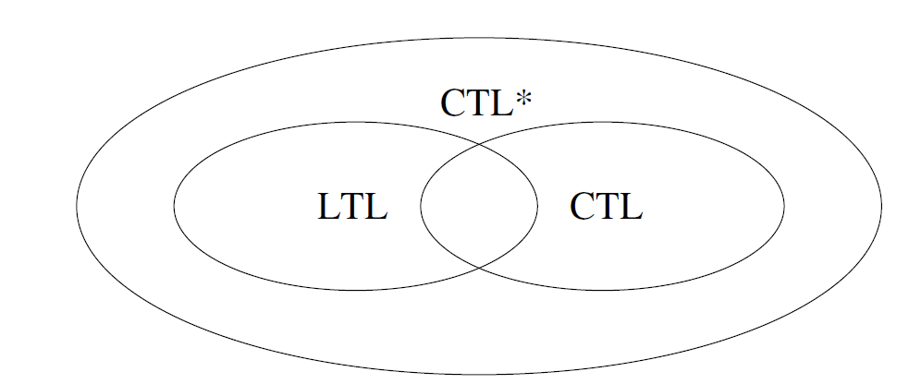
CTL*

Slide 4
CTL* using Kripke Structure
Kripke structure is used to define the semantics of CTL*.
Two types of formulas used in CTL* are state formulas and path formulas.
  State formulas are interpreted with respect to states
  Path formulas are interpreted over paths.

Slide 5
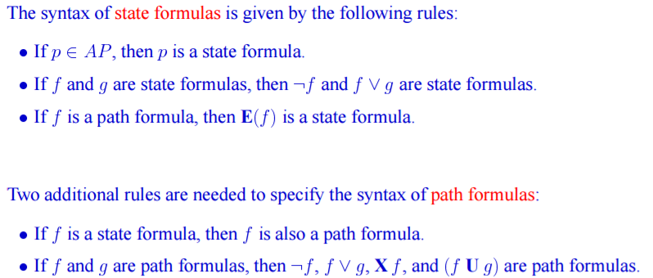
Path formula Vs State Formula

Slide 6
Temporal logic expressive power
We discussed three different logics, each having different expressive powers
For example; there is no CTL formula that is equivalent to the LTL formula A(FG p)
Likewise, there is no LTL formula that is equivalent to the CTL formula AG(EF p)
The disjunction of A(FG p) v AG(EF p) is a CTL* formula that is not expressible in either CTL or LTL

Slide 7
CTL* State formulas
CTL* has the same operators used in CTL.
CTL* syntax is defined using propositional variables (P), logical operators, and temporal operators.
The formulas of CTL* is formally defined as follows:

Slide 8
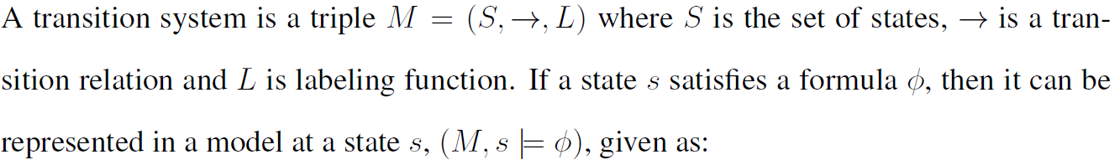
CTL* State formulas
Semantics

Slide 9
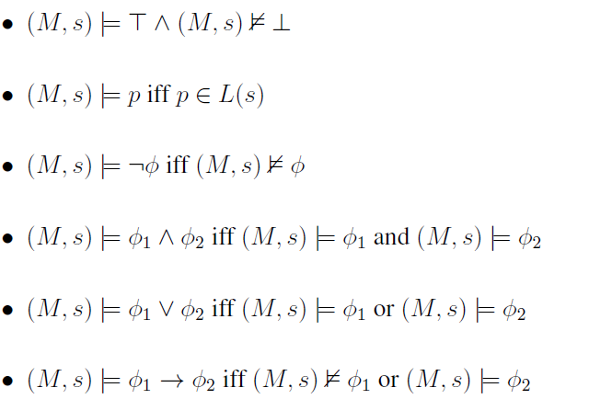
CTL* State formulas
Semantics

Slide 10
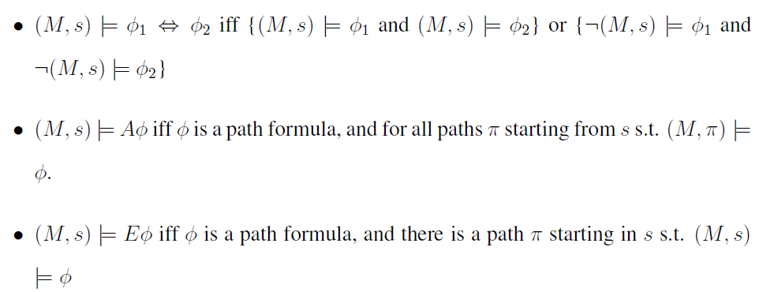
CTL* State formulas
Semantics

Slide 11
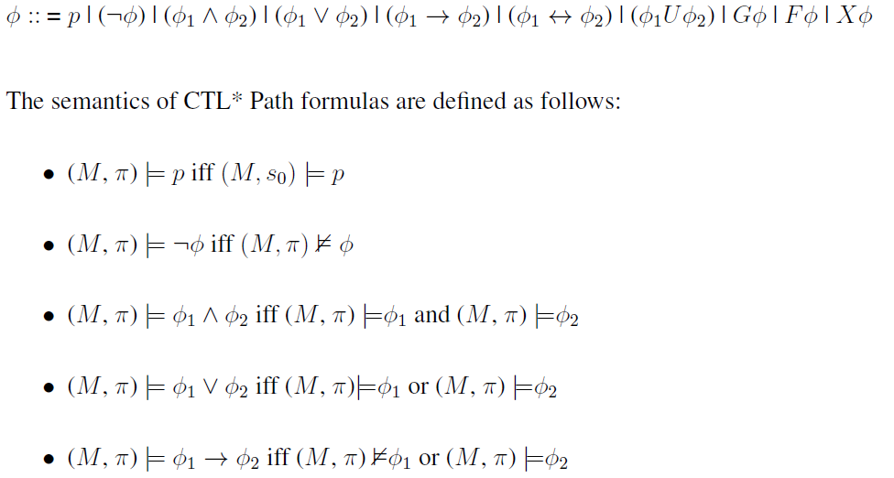
CTL* Path formulas
Syntax

Slide 12
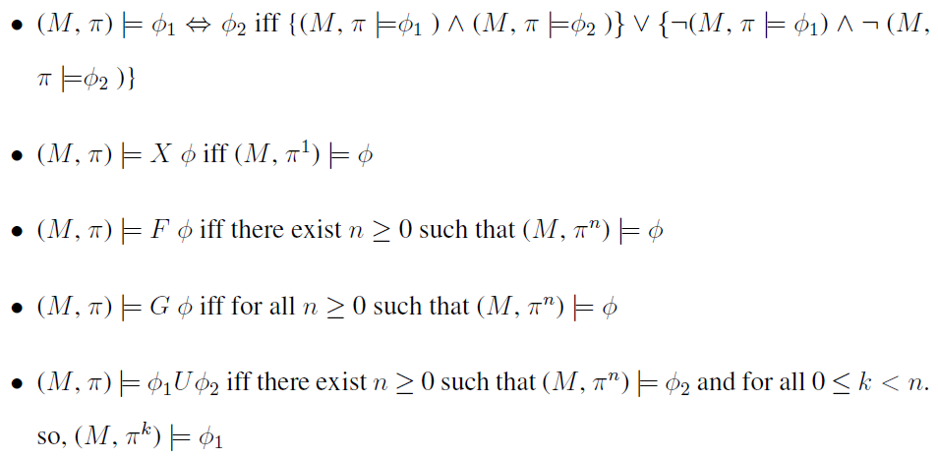
CTL* Path formulas
Semantics

Slide 13
Analysis of Temporal Logic?
Three temporal logics discussed above are different in terms of expressive powers, quantifiers, structures and behavior of the systems.
Linear Time Temporal Logic (LTL) is more straight forward to use and have the individual paths (Path formulas).
Computational Tree Logic (CTL) has the ability to quantify paths. Its formulas like AF p seems hard to understand.

Slide 14
Analysis of Temporal Logic?
CTL* is more expressive than CTL and LTL but computationally it is much more expensive.
CTL* is very useful for developing and checking correctness of complex reactive system.

Slide 15
Thanks

